Slide 1

Using data analytics to study the multi-modal
Influence of the environment
on human cognitive performance
Oleksandr Burov, Svitlana Lytvynova, Olha Pinchuk, Olena Kuzminska,
Oleksii Tkachenko, Natalia Kovalenko, Svitlana Agadjanova
Institute for Digitalisation of Education
of National Academy of Educational Sciences of Ukraine

Slide 2
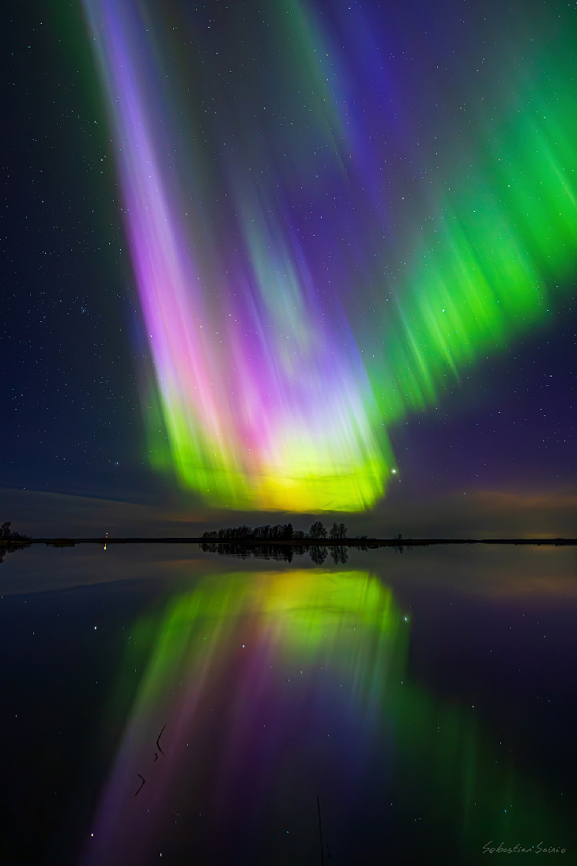
INDEX:
Problem statement
Research findings related to the article’s topic
The methodology of the research with special attention to the technique of experimentation
Results
Discussion of the findings
Outcomes

Slide 3
2. ABSTRACT:
The analysis of multi-modal data, especially related to such a complex object as a human in the loop of human-system integration can be more effective if applying the data analytics methodology.
In our research we studied indicators:
human performance of regular cognitive tests over 6 weeks,
physiological measurements of HRV and blood pressure,
external indices:
atmospheric pressure,
solar wind,
inter-planet field,
geomagnetic fields
anisotropic index.
This research proposes the technique based on
descriptive analysis of human indicators of cognitive performance including comparison of variations of indicators at levels of a human and inter-human variation;
multiple regression analysis with the stepwise procedure to select the most informative indicators among potentially influencing factors;
summarizing data visualized representation of revealed indicators
that can be included in descriptive models.
It has been revealed that the most influences indicators: HRV, total strength of the interplanetary magnetic field Bt, SW density and anisotropic index.

Slide 4
3. INTRODUCTION:
We are living in conditions when we receive more data every day than ever before. Big data and data analysis become the core of many fastest-growing jobs in the next five years.
Accelerating digital transformation of many areas of our life needs people working with streams of information of varying intensity, cognitive difficulty and responsibility.
Especially this is important for emergent industries where a human interoperates with digital technologies, is integrated with them and affected by information streams from them.
Not only the workload affects human performance efficiency, but conditions of activity both internal and external. The latter are associated with organizational, hygienic, climate and cosmological ones.
Human reliability and fitness-for-duty are unstable and less predicted values in comparison to technical system’s ones. This is the cause of 70+ % of accidents and malfunctions of human-machine systems.
The reduction of losses can be achieved by knowing the mechanisms of influence of external factors on a human’s state and performance to avoid/mitigate such a negative impact in operating conditions.

Slide 5
4. LITERATURE REVIEW :
 | Space Weather (solar) | Space Weather (Galactic Cosmic Radiation, GCR) | GMF | SW + metheo/microgravity
Work | De Ninno & Pregnolato 2016; |  | Alabdulgader et al. 2018
Life | Chizhevsky 1926, 1973 Hunting et al. 2021 | Parihar et al. 2016 | Alabdulgader et al. 2018 | Alabdulgader et al. 2018
Health (menthal health) | Zilli 2019 | Gupta et al. 2023 | Cherry 2002; Tarlaci and Pregnolato 2016 | Gupta et al. 2023
Cognition | Burov & Tsarik 2012; 2021 Liddie et al. 2024 | Desai et al. 2023 | Babayev & Allahverdiyeva 2005 | Zenchenko and Breus 2021
Physiological response | Odell 2020; McCraty et al. 2017 | Miry et al. 2021; Cahoon et al. 2023 | Besser 2007; McCraty et al. 2017; | Zenchenko & Breus 2021
Psyco-Physiological | Chizhevsky 1973; Burov et al. 2007 | Gupta et al. 2023 | Babayev & Allahverdiyeva, 2007; Tarlaci and Pregnolato 2016 | Gupta et al. 2023; Hayrapetyan et al. 2025
Colored study corresponds to the quantitative measurements: green – animals, purple – humans.

Slide 6
5. RESEARCH GAPS :
1. Knowledge Gap:
A lack or insufficient information and clear understanding about factors and their parameters influencing a human in conditions of performance.
2. Conceptual Gap:
A need to clarify/redefine concepts, theories, or frameworks of different ways (multimodal) of the space influence a human’s life and activity with possible high accuracy and prediction.
3. Theoretical Gap:
A need to develop/refine a methodology to explain a phenomenon of the space weather (SW) influence a human’s physiological and cognitive responses that result his/her behavior, performance and health.
4. Methodological Gap:
A need to develop or improve research methods, tools, or techniques for measurement, assessment and prediction of consequences of the SW influence a human with high accuracy.
5. Empirical Gap:
A lack of empirical evidence to support developments to avoid the methodological gap mentioned above.
6. Evidence Gap:
A need to gather more evidence-data to inform science and practice, as well as decision-makers about humans’ target groups of possible CW influence and its degree/level.
7. Practical Gap:
A need to translate research findings into practical applications into measurable and assessable indicators suitable for constructing applied models of assessment and forecasting.
8. Data Gap:
A lack of reliable and accurate data to support research on the base of regularly collected and reproduced data accounting the individual and typological features of the people examined.
9. Population Gap:
A need to study a specific population or subgroup that is homogenous enough to draw valid conclusions. Differences in target groups (age-, gender-, trained-depended) can be significant.

Slide 7
6. PROPOSED METHODOLOGY :
Data identification
Test performance used in our previous research of the multimodal recognition of the stress when performing cognitive tasks.
Data measured and stored in this research included modalities: operational, subjective evaluation of the subject’s state, medical data, space weather parameters and atmospheric pressure.
Data collection
ICT to monitor the cognitive activity of subjects (10 ICT professionals with experience 5+ years, males, aged 21-31 years). Experiment duration: 6-7 weeks (3 times per week, the same daytime).
Data cleaning
Main reasons of the data safety decrease in our research analysis:
General numbers of tests’ days varied from subject to subject, because the sessions were organized in their actual workdays in their workplaces.
The survey included test performance (2 types of logical tasks, free and fixed tasks’ appearance time), blood pressure (systolic BPs and diastolic BPd) and heart rate (HR) before the test performance and afterwards. The time of the task performance (Ttp6 and Ttp5 respectively, in milliseconds) and reliability (η6 and η5) were measured and stored. Test session: 10 minutes long.
Measuring real indices of multi-modal factors (external ones) may be affected in loss of some of the indicators that should be accounted at the stage of analysis.
"Outliers" beyond physically reasonable values ​​were double checked and excluded from further analysis if necessary.
Space weather and atmospheric pressure were registered as external factors.
Indices of proton component of solar wind speed SWsp (km/s) and density SWden (proton/sм³) in time of the test session, as well as 1 hour, 3 hours and 6 hours before it. Parameters of the solar wind as follows: proton density and speed; electron flux (Ef) in bands 47-68, 115-195, 310-580, 761-1220 and 1060-1900 KeV.
Indices of the interplanetary magnetic field Bx, By, Bz and Bt.
Anisotropy index AnI.
Parameters of the geomagnetic field (GMF): planetary index Кs, index of “equivalent amplitude” A.
Variation statistics (descriptive analysis): averaging of data for each indicator of state and activity, the coefficient of variation of indicators, and the reliability of completing tests’ tasks for each subject.
As subjects performed tests under different time pressure (free and fixed), we evaluated the difference between tests T6 and T5 performance by the t-Student criteria.
Inter-subject variation of performance indices including coefficient of variation. Individual subjects’ variation has been compared with the inter-subjects’ one.
Multiple Regression Analysis (forward stepwise, 4 including indices) was carried out to find the most informative indices from internal (BPs, BPd and HR) and external ones.
Data analyzing
The content analysis of the results obtained is provided in the next step.
Results interpreta-tion

Slide 8
7. RESULTS & DISCUSSION:
Table 1. Tests’ performance descriptive data, 10 subjects
Subject's Code | # of tests’ session | Ttp6, ms | Ttp5, ms | cvM6, % | cvM5, % | η6 | η5
S1 | 26 | 3239,5 | 2531,2 | 49,7 | 34,8 | 0,93 | 0,76
S2 | 27 | 2878,5 | 2222,1 | 46,1 | 31,2 | 0,97 | 0,88
S3 | 28 | 2519,2 | 1909,5 | 44,5 | 34,8 | 0,97 | 0,86
S4 | 26 | 2851,7 | 2213,4 | 43,5 | 30,2 | 0,95 | 0,84
S5 | 25 | 2044,2 | 4117,3 | 32,9 | 42,3 | 0,75 | 0,53
A1 | 13 | 3050,3 | 2231,4 | 43,7 | 30,1 | 0,98 | 0,9
A2 | 15 | 4091,2 | 2936,1 | 56,7 | 31,8 | 0,92 | 0,77
A3 | 21 | 4226,9 | 2652,9 | 63,9 | 35,8 | 0,93 | 0,76
A4 | 22 | 3133,6 | 2351,7 | 58,4 | 38 | 0,84 | 0,72
A5 | 25 | 2231,1 | 1419,9 | 39,6 | 34,1 | 0,98 | 0,96
Subjects:
Group S – experiment days April-May
Group A – experiment days May-June.
Ttp(S) vs. Ttp(A): p < 0,5.
T5 vs. T6 differences by parameters M and η : p ≤ 0.01.
Average variation of inter-subjects’ coefficients of variation:
T5 (CV cvM5 = 11.1%) vs. T6 (CV cvM6 = 19.6%).
Limitation of the time for tasks’ performance required higher efforts in the subjects’ regulatory systems.

Slide 9

7. RESULTS & DISCUSSION:
Table 2. Indices included in regression models (example of 2 subjects)
 | Subject S1 |  |  |  | Subject A5
 | Tpt6 | Tpt5 | Rel6 | Rel5 | Tpt6 | Tpt5 | ηl6 | ηl5
BPs | ≠ 0 | ≠ 0 | ≠ 0
BPd |  | ≠ 0
HR | ≠ 0 |  |  |  |  | ≠ 0 | ≠ 0
SWspeed
SWdencity-1
SWdencity-3
SWdencity-6 |  |  |  |  |  |  |  | ≠ 0
SWdencity |  |  | ≠ 0 |  | ≠ 0 | ≠ 0 |  | ≠ 0
Kp |  |  |  | ≠ 0
A
Ef 47-68
Ef 115-195
Ef 310-580
Ef 761-1220 |  |  |  |  | ≠ 0
Ef 1060-1900
Bx |  |  |  |  | ≠ 0 | ≠ 0
By | ≠ 0 | ≠ 0 | ≠ 0
Bz |  |  |  |  |  |  |  | ≠ 0
Bt | ≠ 0 | ≠ 0 |  | ≠ 0 | ≠ 0 | ≠ 0 |  | ≠ 0
AIn |  |  |  | ≠ 0 |  |  | ≠ 0
Atm.Pressure |  |  | ≠ 0 | ≠ 0
R = … | 0.86 | 0.89 | 0.89 | 0.82 | 0.77 | 0.80 | 0.52 | 0.85
p ≤ … | 0.001 | 0.001 | 0.001 | 0.01 | 0.001 | 0.001 | 0.01 | 0.001
Stepwise regression
K = 21 → 4
Example (subject S1):
Tpt6 = -3698,2 + 0.936 BPs + 0.403 HR - 0.28By + 0.225 Bt
Table 3. Summarized informative independent variables by all models
 | Tpt6 | Tpt5 | Rel6 | Rel5
BPs | +++++ | ++++ | ++ | +++
BPd | ++ | +++ | ++ | +++
HR | +++++ | +++ | ++++++ | ++
SWspeed |  | + | +
SWdencity-1 | + | ++ |  | +
SWdencity-3 | + |  |  | +
SWdencity-6 | +++ | ++ | ++ | ++
SWdencity | ++ | +++++ | ++++ | +++
Kp |  | + |  | ++
A |  | + | ++
Ef 47-68 | ++ | ++ | ++
Ef 115-195 |  |  | +
Ef 310-580 |  |  |  | +
Ef 761-1220 | + |  | +
Ef 1060-1900 | ++ |  | ++ | ++++
Bx | ++ | ++ | + | +
By | +++ | ++ | + | +
Bz | + | +++ | +++ | ++
Bt | ++++++ | ++++ | +++ | +++
AIn | ++++ |  | +++++ | ++
Atm.Pressure | +++ | + | + | ++++

Slide 10
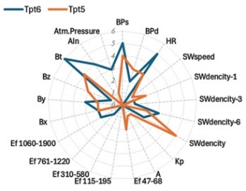
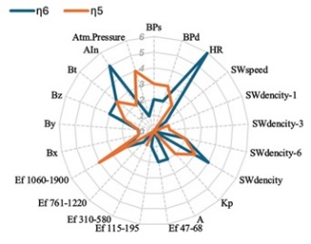
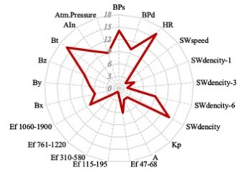
8. COMPARATIVE ANALYSIS:
The number of indices of internal and external factors that were included in models (10 subjects):
a – models of the rate of tests’ performance b – models for reliability.
c – summarized number of indices including in all models.

Slide 11
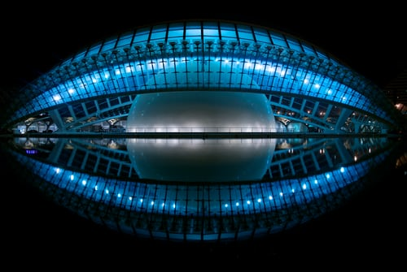
9. CONCLUSION & FUTURE WORK :
This research has confirmed that data analytics’ methodology and techniques could be effective tools to analyze multi-modal data in relation to such a complex object as a human in the loop of the human-system integration.
The appropriate technique includes descriptive analysis of human indicators of performance including variation of these indicators at levels of individual human and inter-human variations; multiple regression analysis with the stepwise procedure to select the most informative indicators among potentially influencing factors; summarizing data visualized representation of revealed indicators that can be included in descriptive models.
It has been revealed that the most influences indicators: HRV, total strength of the interplanetary magnetic field Bt, SW density and anisotropic index
Such models can have potential to be used for predictive analytics of successful human cognitive performance.
Our findings should be evaluated as preliminary results to be revealed by data analytics techniques and needed to be studied further as a perspective indicator in studying human performance, especially in digital environment.

Slide 12
10. REFERENCES :
Alabdulgader A, McCraty R et al. (2018) Long-Term Study of Heart Rate Variability Responses to Changes in the Solar and Geomagnetic Environment. Sci Rep, Feb 8;8(1):2663. doi: 10.1038/s41598-018-20932-x
Bennett CL et al (2013) Nine-Year Wilkinson Microwave Anisotropy Probe (WMAP) Observations: Final Maps and Results. Astrophys J Suppl, 208 (2): 20. arXiv:1212.5225
Burov You, Gerasimov BM (2005) Methodology and models for studying the influence of heliophysic factors on the performance of operators. In: HF: Challenges of Psychology and Ergonomics, 3, pp. 67-71
Burov O, Tsarik O (2012) Educational workload and its psychophysiological impact on student organism. Work, 41(Suppl. 1), 896-899. https://doi.org/10.3233/wor-2012-0260-896
Cahoon D. et al. Effects of HZE-Particle Exposure Location and Energy on Brain Inflammation and Oxidative Stress in Rats. Radiation Research 200(5), 431-443, (27 September 2023). https://doi.org/10.1667/RADE-22-00041.1
Chai Z, Wang Y, Li YM, Zhao ZG, Chen M. (2023) Correlations between geomagnetic field and global occurrence of cardiovascular diseases: evidence from 204 territories in different latitudes. BMC Public Health, Sep 11; 23(1):1771. doi: 10.1186/s12889-023-16698-1
Chakraborty S, Rae IJ, Killey S, Ojha B, Watt CEJ, Potts C, Irving E, Elliott G, Johnson K, Mohammed N, Gupta T, Slater T, Liu X and Cheng Y (2024) Statistical survey of pitch angle anisotropy of relativistic electrons in the outer radiation belt and its variation with solar wind/geomagnetic activity. Front. Astron. Space Sci 11:1474503. doi:10.3389/fspas.2024.1474503
Cherry NJ (2003) Human intelligence: The brain, an electromagnetic system synchronised by the Schumann Resonance signal. Medical Hypotheses, Volume 60, Issue 6, 843-844. https://doi.org/10.1016/S0306-9877(03)00027-6.
Danho S et al. (2019) Innovative technical implementation of the Schumann resonances and its influence on organisms and biological cells. IOP Conf. Ser.: Mater. Sci. Eng. 564 012081. https://doi.org/10.1088/1757-899X/564/1/012081
Desai, R.I., Kangas, B.D., Luc, O.T. et al. Complex 33-beam simulated galactic cosmic radiation exposure impacts cognitive function and prefrontal cortex neurotransmitter networks in male mice. Nat Commun 14, 7779 (2023). https://doi.org/10.1038/s41467-023-42173-x
Gullett N, Zajkowska Z, Walsh A, Harper R, Mondelli V (2023) Heart rate variability (HRV) as a way to understand associations between the autonomic nervous system (ANS) and affective states: A critical review of the literature. Int J Psychophysiol, 192:35-42. doi: 10.1016/j.ijpsycho.2023.08.001
Gupta U., Sheharyar Baig, Arshad Majid, Simon M Bell. The neurology of space flight; How does space flight effect the human nervous system? Life Sciences in Space Research, Volume 36, 2023, Pages 105-115, https://doi.org/10.1016/j.lssr.2022.09.003
McCraty R et al. (2017) Synchronization of Human Autonomic Nervous System Rhythms with Geomagnetic Activity in Human Subjects. International Journal of Environmental Research and Public Health. 14(7):770. https://doi.org/10.3390/ijerph14070770
Miry O. et al. Life-long brain compensatory responses to galactic cosmic radiation exposure. Sci Rep. 2021 Feb 22;11(1):4292. doi: 10.1038/s41598-021-83447-y. PMID: 33619310; PMCID: PMC7900210.
Hayrapetyan,H.G. et al. Combined influence of fluctuations in the environmental conditions and space weather on the chrono-periodic system in cardiovascular pathology. Int J Biometeorol 69, 1507–1516 (2025). https://doi.org/10.1007/s00484-025-02918-3
Rezaei S, Seyedmirzaei H, Gharepapagh E et al (2024) Effect of spaceflight experience on human brain structure, microstructure, and function: systematic review of neuroimaging studies. Brain Imaging and Behavior 18, 1256–1279. https://doi.org/10.1007/s11682-024-00894-7
Tarlaci S and Pregnolato M (2016) Quantum neurophysics: From non-living matter to quantum neurobiology and psychopathology, Int J of Psychophys, Volume 103, 2016, Pages 161-173, https://doi.org/10.1016/j.ijpsycho.2015.02.016
Zenchenko TA and Breus TK (2021) The Possible Effect of Space Weather Factors on Various Physiological Systems of the Human Organism. Atmosphere, 12(3), 346. https://doi.org/10.3390/atmos12030346

