Slide 1
NAU PHD SYMPOSIUM 2021
November 30, 2021
Implementation of the Model of STEM Technologies in the Innovative Scientific-Educational ECO-Environment of an Educational Institution Based on Digitalization
Speaker: Мarina Rostoka, Ph.D of Pedagogical Sciences, Senior Researcher

Slide 2
PROBLEM STATEMENT The relevance of the proposed issues
1. Transformational Trends in the Development of STEM Education in Technical Institutions of HE
STEM-EDUCATION
Hard and soft-skills
Increasing the flow of information
New professions
Information
and technological progress

Slide 3
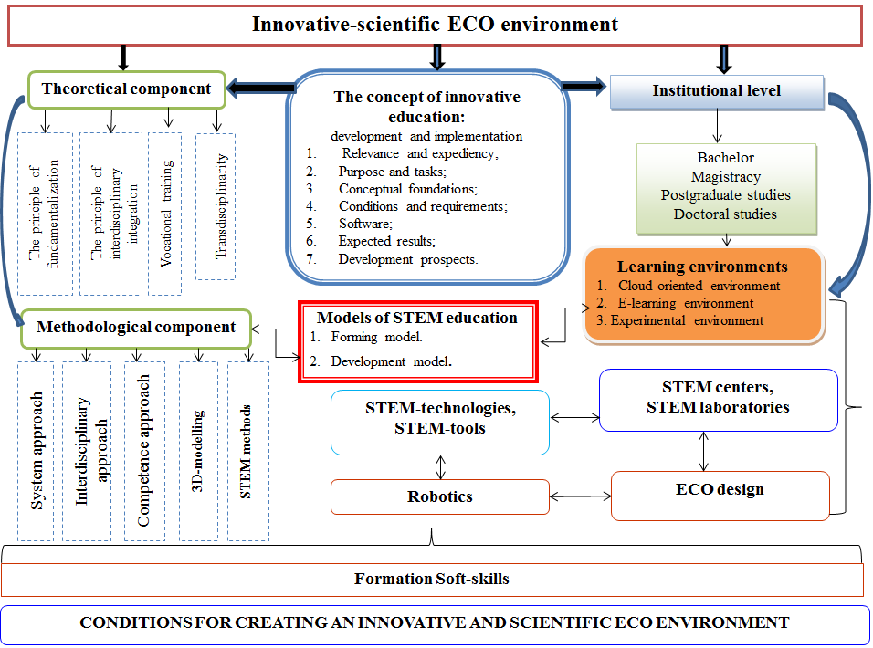
2. Substantiation of the Conceptual and Semantic Model of ECO Environment on the Basis of STEM Education

Slide 4
Mechatronics
Modelling of aircraft
Prototyping
3-D modelling
Digital equipment
Cloud-oriented technologies
Modification of the content component of STEM education
Electronics
Mobile robotics
Integrated approach
Формування інноваційного навчального середовища
Modernization of teaching methods of natural and technical disciplines
Competence approach
E-learning
STEM-education
Transdisciplinary approach
A combination of virtual
and real experiments
Variable learning based on STEM technologies
Continuous learning
Scientific research work
System approach
Advanced training courses in the areas of STEM education
Internship
Project activity
An innovative approach to distance learning
Educational activities in the context of STEM education
Internet of Things smart devices
Grants
(foreign, domestic)
Short-term
STEM programs
Coursework
Integrated, interdisciplinary curricula
Fundraising
Facilitation
Medium- urgent
Aeromodelling
Long-term
Physical and chemical technologies

Slide 5
The Effectiveness of STEM Technologies in the Educational Process of Technical Institutions of HE, %
Criteria for student readiness based on STEM technologies | Disciplines | Efficiency, %
The motivation of students on the direction of the use of STEM technologies | Physics Avionics Robotics Software engineering | 79,3 64,5 61,3 71,6
Formation of students' knowledge about the readiness to implement STEM technologies in practical work | Physics Avionics Robotics Software engineering | 75,1 69,2 71,6 83,4
Independence and originality of students' solution of innovative problems with the use of STEM technologies | Physics Avionics Robotics Software engineering | 72,8 78,5 76,1 79,5

Slide 6
Conceptual and Semantic Model of ECO-environment
TECHNICAL DEVELOPMENT STRATEGY
Educational programs for the preparation of applicants for higher education at the level of bachelor, master, doctor of philosophy and doctor of sciences
Social order for competitive employees
Internal stakeholders
External stakeholders
Theoretical and methodical bases of training of software engineering and physical and technical disciplines based on STEM technologies of technical institutions of HE:
regulatory support of STEM education; theories, patterns, principles of STEM education, categories of innovation processes; orientation of teaching methods of software engineering, physics and technical disciplines on transdisciplinary, ontological and system approaches
STEM technologies as a means of innovative development of technical institutions of HE
Stages of realization of STEM technologies in technical institutions of HE
I. Strategic-projective
ІІ. Introduction of STEM technologies
III. Productive use of STEM technologies
Contents of technological implementation of STEM technologies
Study of statistical data on trends in STEM education.
Formation of mission, strategy, development of the taxonomy of the purposes of development of STEM education concerning the educational process of the technical institution of HE.
Establishing links between STEM education and the components of the education system.
Development of innovative curricula, work programs and teaching methods based on STEM education technologies.
Forecasting the further development of the technical institution of HE and initiating the next innovative technologies.

Slide 7
Conditions for Creating a Model of Innovative-Scientific ECO-Environment
pedagogical
methodical
technological
psychological
economic

Slide 8
Peculiarities of Transdisciplinary Interaction in the Educational Process
The structure of modern scientific knowledge is formed in four areas:
Constant and dynamic interaction
Humanities knowledge
Epistemic knowledge
natural science knowledge, techno-knowledge, socio-knowledge

Slide 9
Methods of teaching software engineering disciplines and physical and technical disciplines based on STEM education technologies
SE
SE DEVELOPMENT
THEORETICAL FACTS EMPIRICAL FACTS
PROFESSIONAL DISCIPLINES BASED ON INTEGRATION ICT AND PHYSICS
EXPERIMENTS (PRACTICE) ON THE APPLICATION OF ICT IN SCIENCE AND EDUCATION
THEORY
CONDITIONS OF EXPERIMENTS RESULTS ANALYSIS
Cycles of Scientific Knowledge of Software Engineering

Slide 10
Content Elements of Professional Training of Professionals in the Context of STEM-Education Development
didactics
theory of education
theory of the content of SE (IT) education
theory of the content of the educational SE (IT) experiment
Psychological
preparation
general psychology,
age psychology
cognitive psychology, psychology of work
axiology
theory of solving SE problems
technology STEM training
personality psychology, psychology of transdisciplinarity
Pedagogically
preparation
Special training
in SE

Slide 11
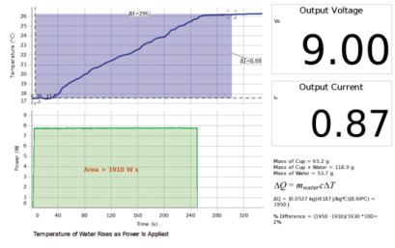
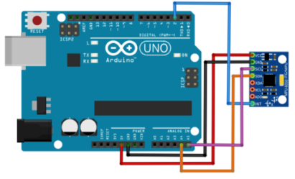
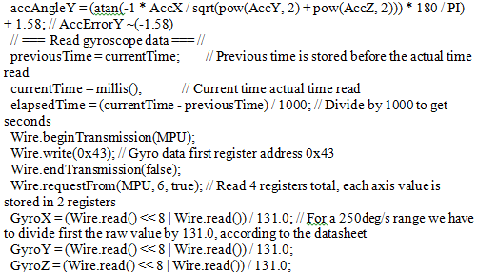
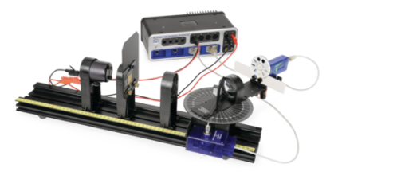
Image of the installation to determine the electrical equivalent of heat: a) installation diagram; b) a graph of power versus time
For example,
Introduction of STEM Technologies in the Educational Process of Higher Education Institutions (Arduino KIT)
During the experiment, PASCO Capstone software is used to study the spectrum of light intensity of black bodies from the wavelength for a light bulb, and the shift of the maximum wavelength is demonstrated for different light bulb temperatures

Slide 12
STEM-Innovation as a Factor of Modernization of Educational Development
INNOVATION POLICY
INNOVATIVE CULTURE
INNOVATIVE EDUCATION
TEACHER OF THE NEW GENERATION
DEVELOPMENT OF ECONOMIC AND SCIENTIFIC AND TECHNICAL PROGRESS
ABILITY TO INTEGRATE INTO THE WORLD SPACE
DEEPENING FUNDAMENTAL KNOWLEDGE. INVOLVING SRW AND LEARNING ENTITIES IN CREATIVE ACTIVITY. EQUAL INTEGRATION INTO THE EUROPEAN AND WORLD AREA
DISCLOSURE OF CREATIVE POTENTIAL OF EDUCATORS. FORMATION OF STEM COMPETENCIES OF EDUCATORS. IMPROVEMENT OF OWN QUALIFICATION IN THE DIRECTION OF STEM EDUCATION OF PW AND SPW

Slide 13
Conclusions
Industry 4.0. and implementation of innovative approaches translates the innovation process in physics in combination with integration with ICT on the basis of STEM education in HEI to a specific technological task, which is solved due to the use in innovation-scientific ECO environment:
1)design technology for innovation in SE in HEI;
2)clear forecasting of the purposes of innovation and guaranteed achievement of results of innovative activity of students in the course of training of SE on the basis of STEM-education;
3)the formation of the optimal volume and sequence of actions and operations required to obtain the predicted results of students in teaching SE with a combination of ICT;
4)reduction of terms of performance of certain stages and operations of educational process on SE on the basis of STEM education;
5)creation of opportunities for change of algorithm of actions, simplification or complication of operations at change of conditions of realization of innovations, growth of innovative potential of HEI.

Slide 14
Prospects for Further Research
are to determine further theoretical and methodological principles and develop a methodological basis for building an information-analytical base for training scientifically oriented students using three-dimensional computer modelling in the context of STEM education in the study of professionally oriented disciplines (software engineering etc.) technical institution of HE.

Slide 15
Thank you for your attention ! I wish you success and health!

